Slide 1
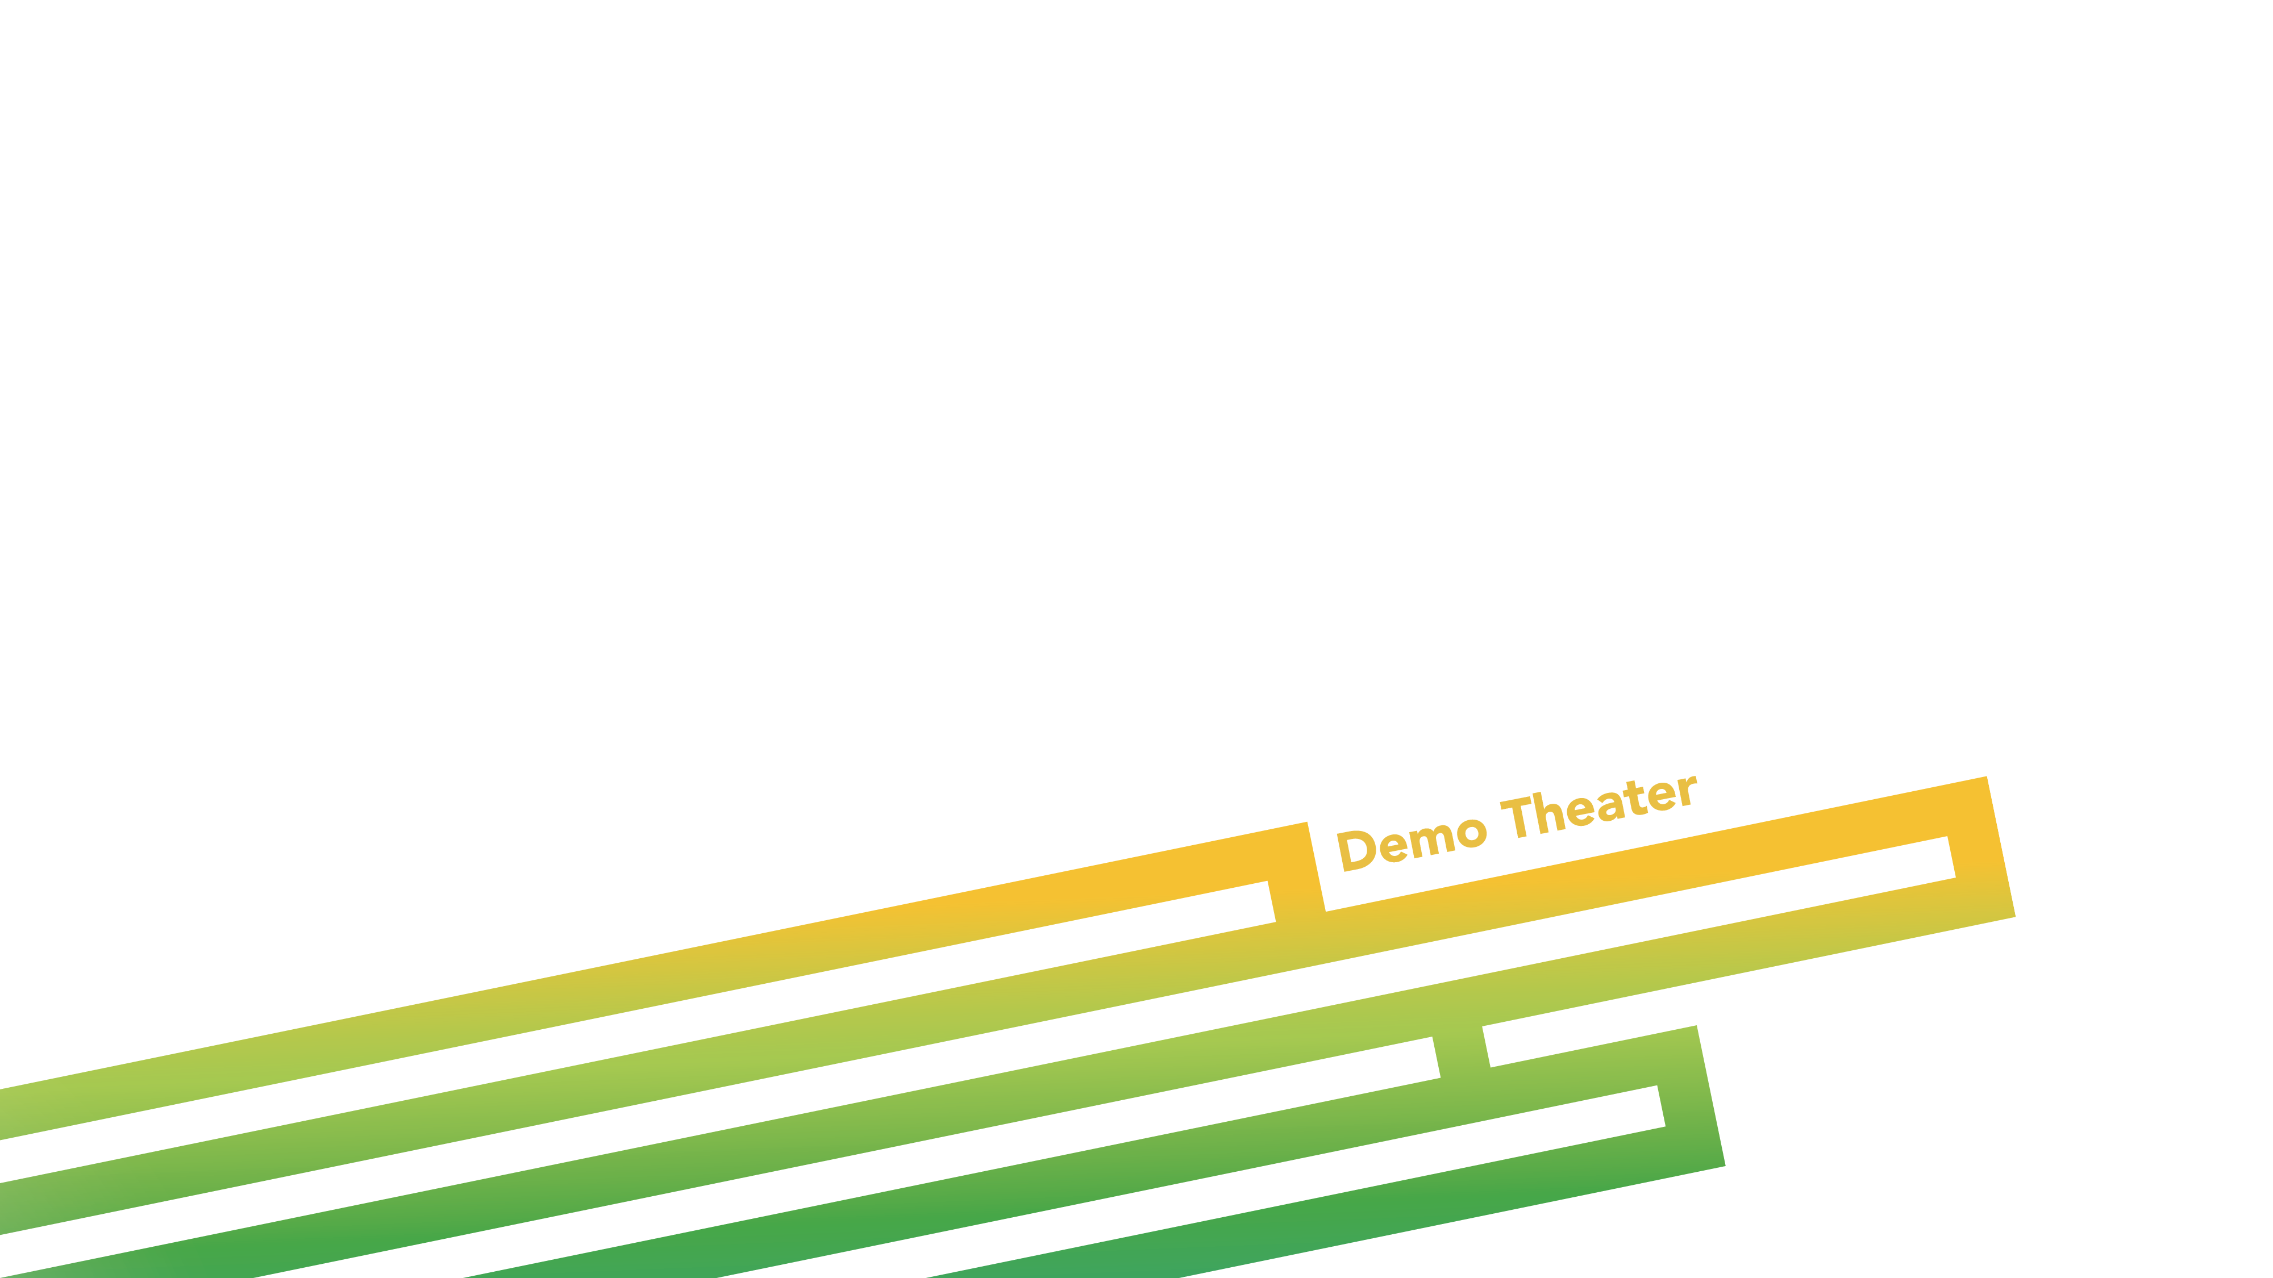
Building Reusable Widgets with ArcGIS API for JavaScript
Derek Swingley @derekswingley
Matt Driscoll @driskull
Notes:
Esri Corporate Template v2.1
16:9 version – April 18, 2014
See http://arczone/resources/presentations.cfm for sample slides and icons

Slide 2
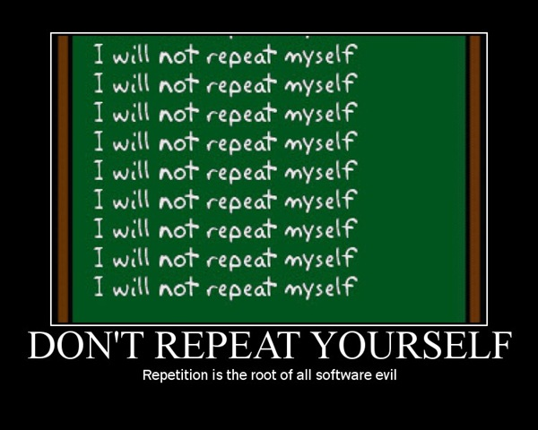
DRY

Slide 3

Dojo Widgets (Dijits)
Important Classes
Sample demo on Github
Help you write a widget
Notes:
Quick start on how to build widgets and extend or use classes like maps
Dojo’s UI Library
Talk about important Dojo classes used to create good widgets
Show how you can write a widget.
See a simple example on github that uses a map

Slide 4
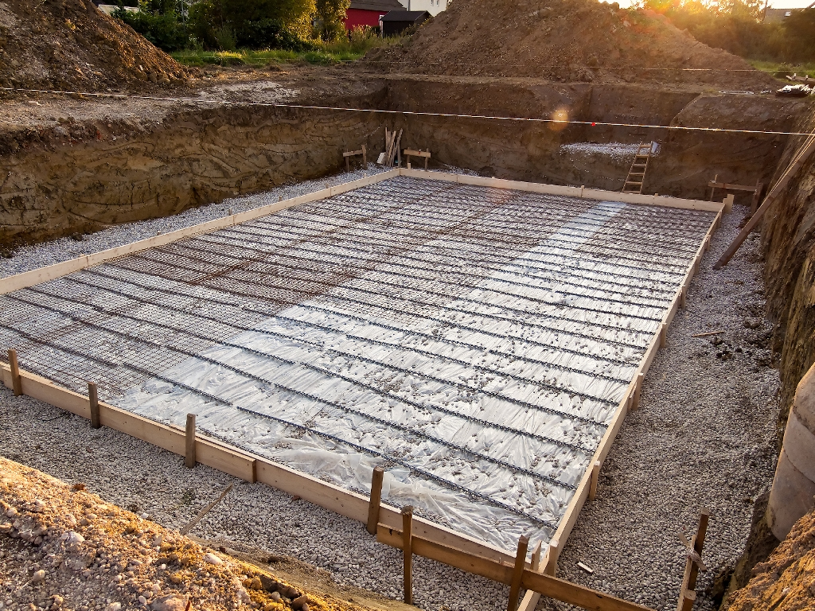
dijit._WidgetBase
Lifecycle methods
Constructor, postMixInProperties, buildRendering, postCreate, startup, destroy
Properties/Attributes
Mixed in
Setters & Getters (Stateful)
Owning handles
.own()
Notes:
Main widget class to inherit
Foundation for creating widgets.
Gives you a solid starting point
Lifecycle methods
See Dojo documentation for widget base for more on the lifecycles and what where you should put your code depending on what you’re doing.

Slide 5
dijit._Templated
<div class="${baseClass}" data-dojo-attach-point="focusNode" data-dojo-attach-event="ondijitclick:_onClick" role="menuitem" tabindex="-1">
<span data-dojo-attach-point="containerNode"></span>
</div>
Template String
Dom Construction
Access Nodes
Attach Points
data-dojo-attach-point
Event attachments
Variable Substitution
${property}
Notes:
If you include the templated class
Show you where to put this template in a sample later
Access nodes for later use with attach points using this.focusNode

Slide 6

dojo/Stateful
Included with Widgetbase
Base class for getting, setting, and watching for property changes
get() & set() methods
Watch()
Custom getters & setters
Notes:
Great class included in wigetbase.
Can be useful with non dijits as well
Set properties
Get properties
Watch properties
Being able to set and watch properties is a nice way have a relationship between a property and a method
We’ll look at these in an example later

Slide 7
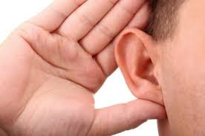
dojo/Evented
Emit Events
Users can listen with “dojo/on”
this.emit("my-event", {});
myWidget.on("my-event", function(evt){});
Notes:
Another helpful class that can be used in widgets or non widgets.
This one isn’t included in widgetbase but is frequently used.
Emit synthetic events
Events can be listend to with dojo/on

Slide 8

Deferreds & Promises
dojo/promise
promise()
all()
first()
dojo/deferred
Notes:
Promise: manages communication between asynchronous threads.
How we can know when something anynchronous is done. Things like animations, timers, network requests. Etc.
Promise is used by dojo/deferred.
Promise is an abstract class implemented through dojo/deferred.
You create a deferred and listen to its promise.
We’ll talk about all and first in the next slides

Slide 9
Dojo/promise/promise
Communication between asynchronous threads
Can be in one of three states: unfulfilled, resolved, rejected
May only change from unfulfilled to resolved or unfulfilled to rejected
Methods
.then()
notification of state change
.cancel()
.always()
.otherwise()
Notes:
Abstract class. Implemented using Deferred
Implements a then method for registering callbacks for notification of state change
Callbacks cannot change the value produced by the promise
A promise's then method returns a new promise, to provide chaining while keeping the original promise's value unchanged

Slide 10

Dojo/promise/first
Takes an array or object of promises
Returns results from first that is fulfilled
first([promise1, promise2]).then(function(result){
// result will be either promise1 or promise2 results,
// whichever is fulfilled first
});
Notes:
Can be used when you just want to do something after you get the first result back.
Only care about one of them resolving, take the first one

Slide 11
Dojo/promise/all
Takes an array or object of promises
Returns new promise with results when all promises are fulfilled or one is rejected
Replaces dojo/DeferredList
all([promise1, promise2]).then(function(results){
});

Slide 12
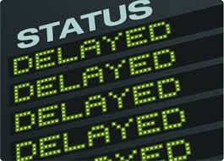
Dojo/deferred
Manages async threads
deferred.promise;
.resolve() / .reject()
dojo/request and esri/request use deferreds
Can be chained
.then()
.cancel()
Notes:
Great for handling when things are done.
animations, network requests, timers
Promise inside of deferred

Slide 13
require(["dojo/Deferred", "dojo/dom", "dojo/on", "dojo/domReady!"],
function(Deferred, dom, on){
function asyncProcess(){
var deferred = new Deferred();
dom.byId("output").innerHTML = "I'm running...";
setTimeout(function(){
deferred.resolve("success");
}, 1000);
return deferred.promise;
}
on(dom.byId("startButton"), "click", function(){
var process = asyncProcess();
process.then(function(results){
dom.byId("output").innerHTML = "I'm finished, and the result was: " + results;
});
});
});
Notes:
Example using deferred in a function

Slide 14
Chained Deferred
require(["dojo/Deferred"], function(Deferred){
var def = new Deferred();
def.then(function(value){
// do something
return something;
}).then(function(something){
// do something else
});
});

Slide 15
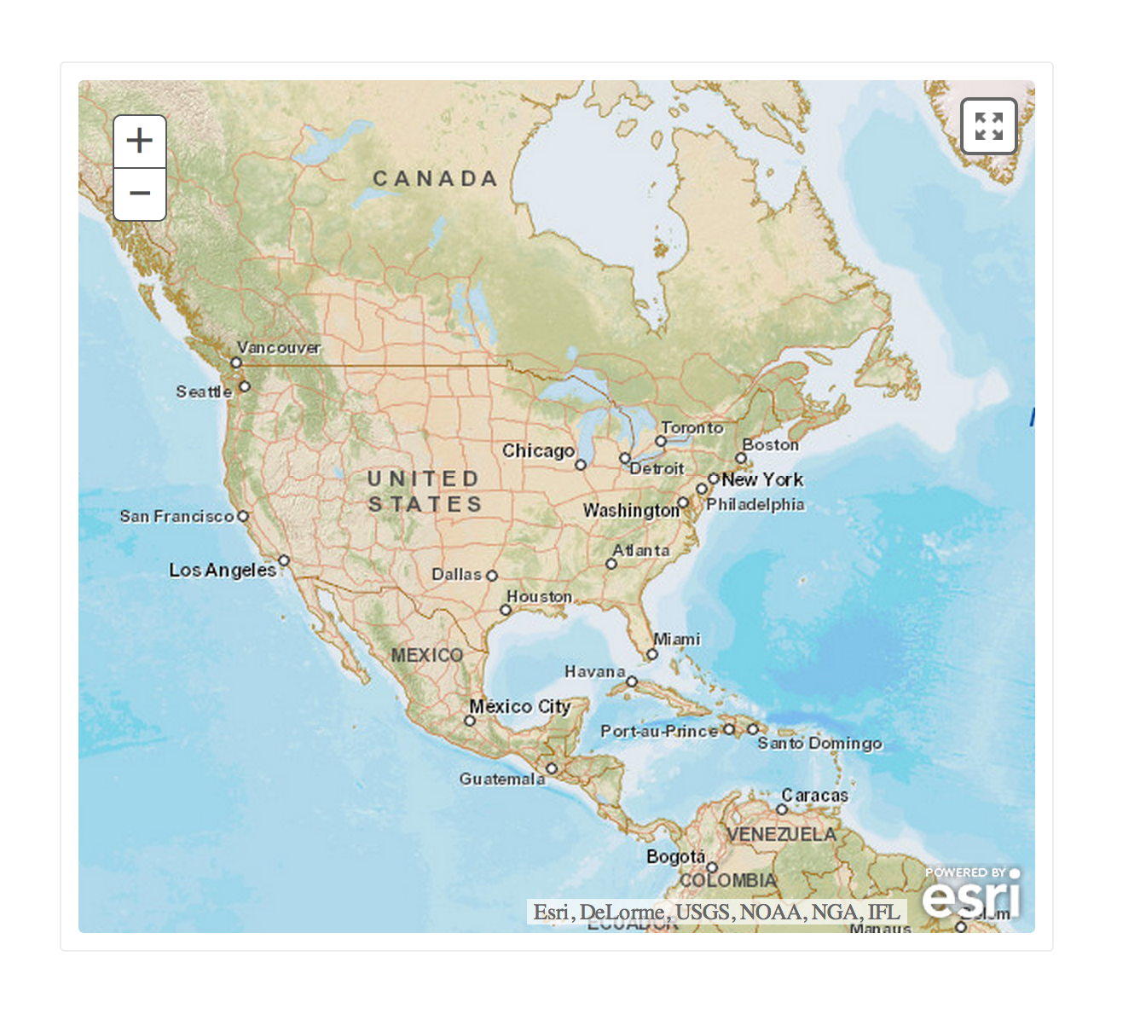
Example Time!
Notes:
Sample time!

Slide 16

Get the code!
github.com/esri
arcgis-dijit-sample-js

Slide 17

Tips & Tricks
Notes:
Quick start on how to build widgets and extend or use classes like maps

Slide 18
Tips
Refer back to the latest Dojo API
Some functions deprecated or replaced
Use newer Dojo functions if available
Use new event handling with on()
Get/Set widget properties with .get() and .set()
watch() widget properties and call update functions

Slide 19
Thank you…
Please fill out the session survey:
Tue 7/15 Offering ID: 1529
Wed 7/16 Offering ID: 1858
Online – www.esri.com/ucsessionsurveys
Notes:
PLEASE INCLUDE THIS SLIDE
Presenters:
Offering ID
– this is in your presenters schedule or the printed agenda (not in the online agenda this year)
- please be sure to update the slide with both IDs if you have more than one session
For attendees: Here are the instructions for users to access the system.
The UC surveys can be accessed from:
My UC Homepage > Evaluate sessions
www.esri.com/ucsurveysessions
The MyUC login is on the back of their badges.
The session can be found through:
1. My planner listings on survey search page
2. Using the Search based on:
Topic, Date, workshop type and event
Offering ID – this is in your schedule or the printed agenda (not in the online agenda this year)
There are 6 quick multiple choice questions plus a space for comments

